Slide 1
Buffer Overreads
Chester Rebeiro
Indian Institute of Technology Madras

Slide 2
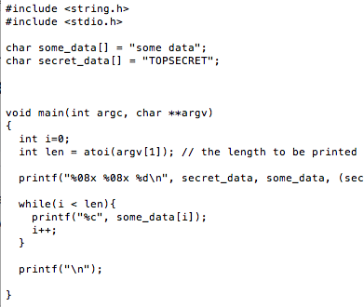

Buffer Overread Example
len read from command line
len used to specify how much needs to be read. Can lead to an overread

Slide 3
Buffer Overreads and Countermeasures
Cannot be prevented by canaries
canaries only look for changes
Cannot be prevented by the W^X bit
we are not executing any code
Cannot be prevented by ASLR
not moving out of the segment

Slide 4

Heartbleed : A buffer overread malware
2012 – 2014
Introduced in 2012; disclosed in 2014
CVE-2014-0160
Target : OpenSSL implementation of TLS – transport layer security
TLS defines crypto-protocols for secure communication
Used in applications such as email, web-browsing, VoIP, instant messaging,
Provide privacy and data integrity
https://www.theregister.co.uk/2014/04/09/heartbleed_explained/
Notes:
https://www.theregister.co.uk/2014/04/09/heartbleed_explained/

Slide 5


Heartbeat
A component of TLS that provides a means to keep alive secure communication links
This avoids closure of connections due to some firewalls
Also ensures that the peer is still alive
Hello World; 12
Hello World; 12
Heartbeat Message
type
length
payload
padding
Notes:
Something like the ping

Slide 6
Heartbeat
Client sends a heart beat message with some payload
Server replies with the same payload to signal that everything is OK
Hello World; 12
Hello World; 12
Heartbeat Message
type
length
payload
TLS1_HB_REQUEST
Notes:
Something like the ping

Slide 7
SSL3 struct and Heartbeat
Heartbeat message arrives via an SSL3 structure, which is defined as follows
length : length of the heartbeat message
data : pointer to the entire heartbeat message
struct ssl3_record_st
{
unsigned int D_length; /* How many bytes available */
[...]
unsigned char *data; /* pointer to the record data */
[...]
} SSL3_RECORD;
Format of data (Heartbeat Message)
type
Length (pl)
payload
Notes:
Something like the ping

Slide 8
Payload and Heartbeat length
Heartbeat Message
type
Length (pl)
payload
payload length (pl)
D_length
payload_length: controlled by the heartbeat message creator
Can never be larger than D_length
However, this check was never done!!!
Thus allowing the heartbeat message creator to place some arbitrary large number in the payload_length
Resulting in overread

Slide 9
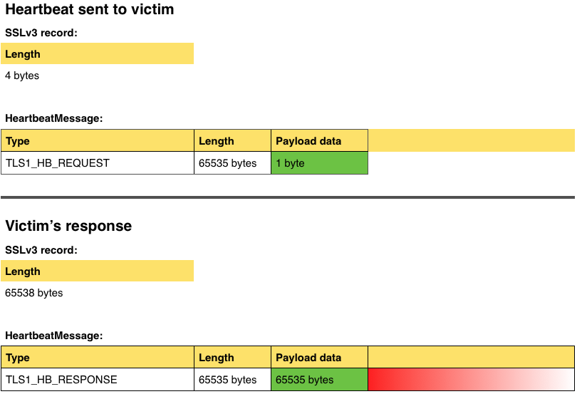
Overread Example
Attacker sends a heartbeat message with a single byte payload to the server. However, the pl_length is set to 65535 (the max permissible pl_length)
D_Length
Victim ignores the D_length (of 4 bytes), looks only at the pl_length and returns a payload of 65535 bytes. In the payload, only 1 byte is victim’s data remaining 65534 from its own memory space.
Notes:
Type is 1 bytes
Length is 2 bytes

Slide 10
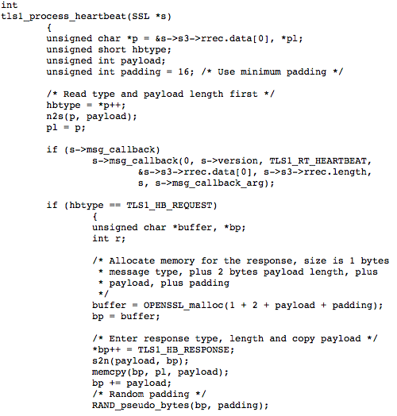
Broken OpenSSL code@victim
1
p points to the attacker’s heart beat packet which the victim just received.
2
get the heartbeat type; fill payload with size of payload (pl in our notation) This is picked up from the attacker’s payload and contains 65535
Allocate buffer of 3 + 65535 + 16 bytes
3
memcpy grossly overreads from the victim’s heap
4
https://git.openssl.org/gitweb/?p=openssl.git;a=blob;f=ssl/t1_lib.c;h=a2e2475d136f33fa26958fd192b8ace158c4899d#l3969

Slide 11
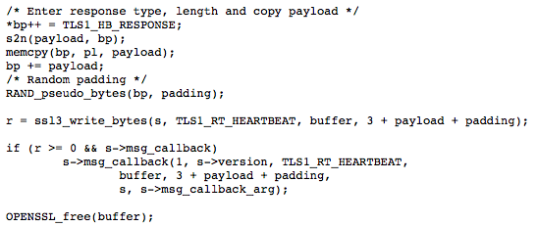
Broken OpenSSL code@victim
5
Add padding and send the response heartbeat message back to the attacker

Slide 12
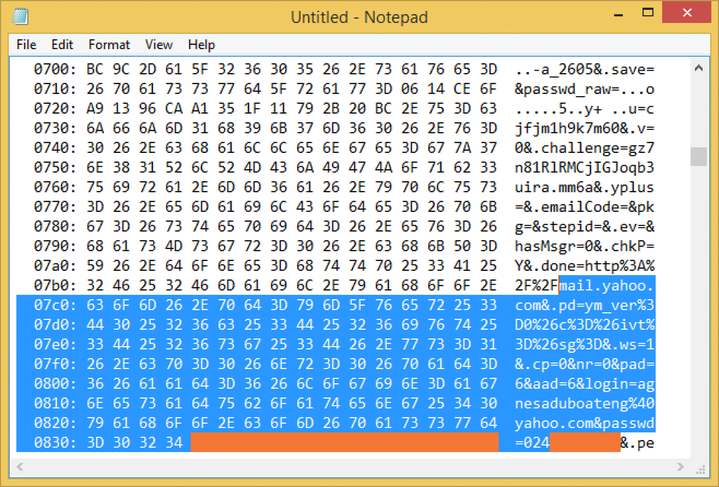
65534 byte return payload may contain sensitive data
Further, invocations of similar false heartbleed will result in another 64KB of the heap to be read.
In this way, the attacker can scrape through the victim’s heap.

Slide 13

Ponder
How would you patch this code so that it cannot be exploited by Heartbleed?

